Slide 1
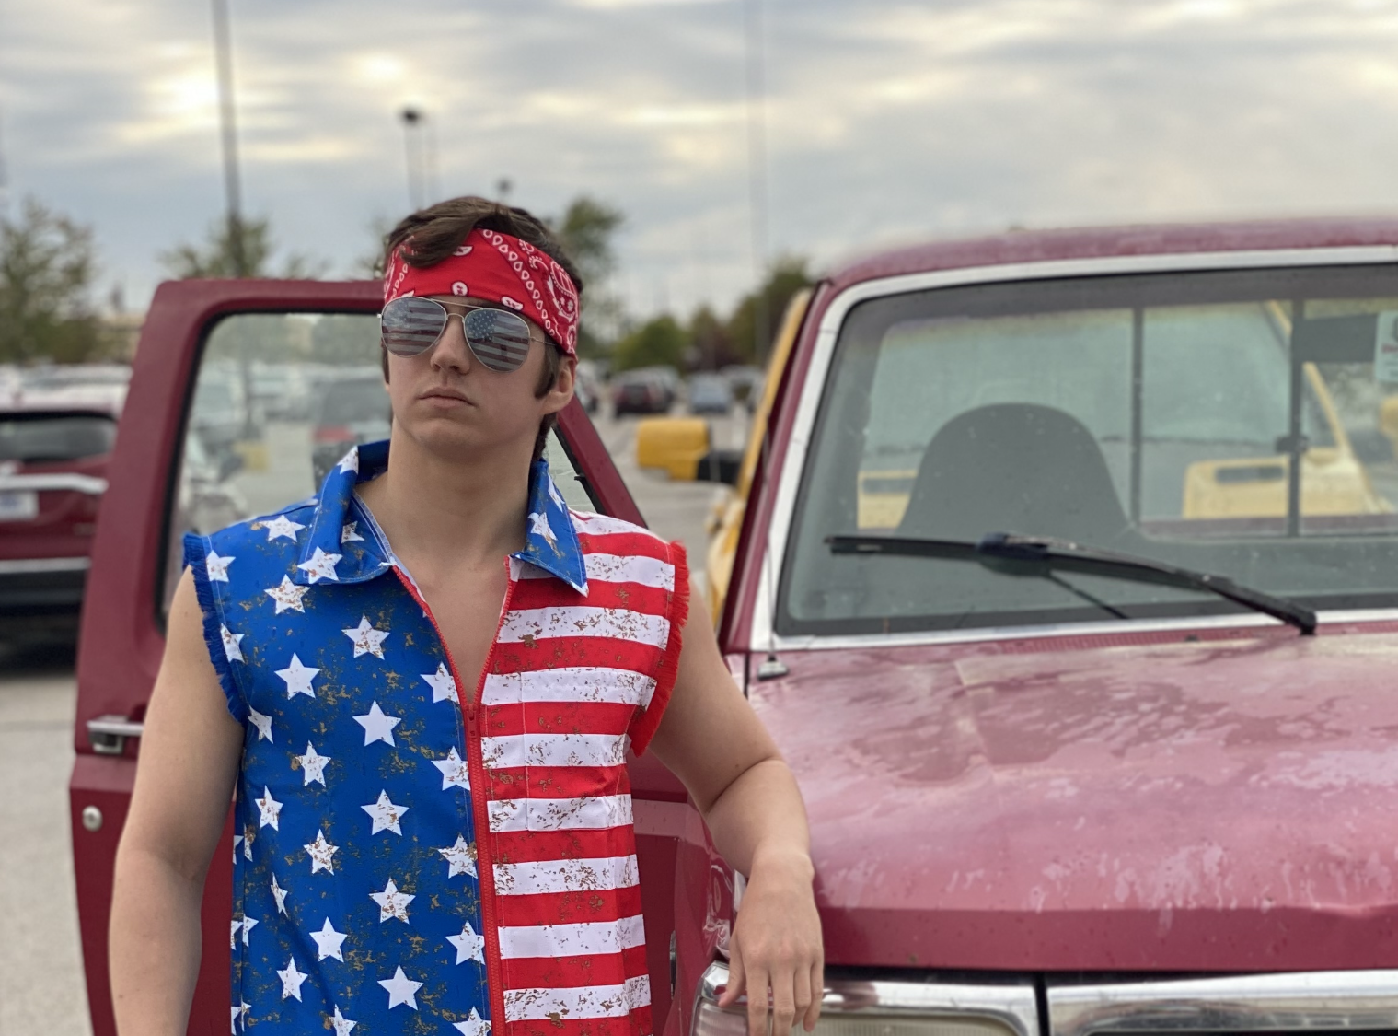
Benjamin Bland
Home | Digital Portfolio | Art Portfolio | About Us | Contact Us

Slide 2
Graphic Arts
Home | Digital Portfolio | Art Portfolio | About Us | Contact Us
This image was created by Benjamin Bland for a project about character design. The assignment was to design one or a few different characters and place them in some type of setting. These characters have extensive backstories coalescing into one scenario being captured in this artwork. It was created using the software Procreate.

Slide 3
Physical Arts
Home | Digital Portfolio | Art Portfolio | About Us | Contact Us
This image was created to convey the same emotion you feel when listening to a specific song. The song choice for this piece was “Forgotten love” by Aurora. The medium was acrylic paint. It is a minimalistic style where the meaning derived from the painting can vary from person to person.

Slide 4
About Us
Home | Digital Portfolio | Art Portfolio | About Us | Contact Us

Slide 5
Contact Us
Home | Digital Portfolio | Art Portfolio | About Us | Contact Us

